Slide 1
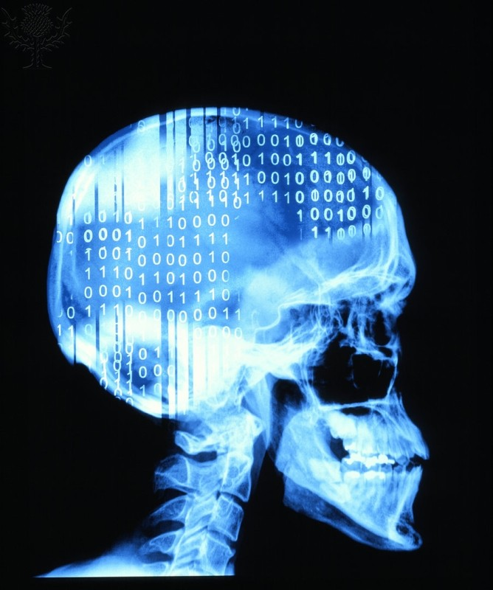
How to train a deep learning model
Sonja Aits
Lund University

Slide 2
AI development is an iterative process
Define
problem
Obtain
data
Prepare
data
Train
model
Evaluate
model
Deploy
model
Monitor
model

Slide 3
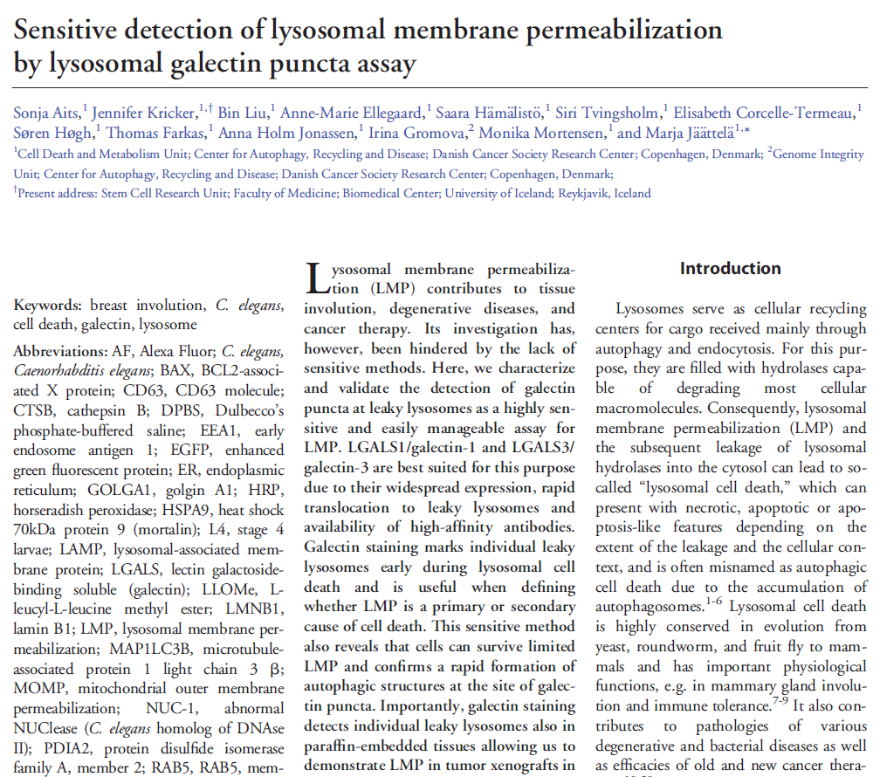
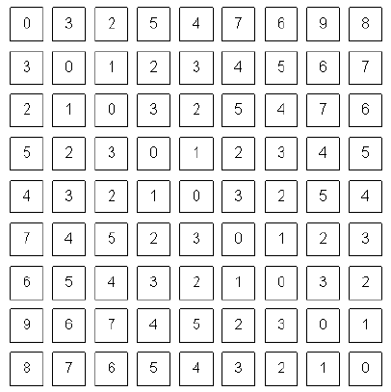
How we
perceive the world
How computers
perceive the world
→ Data needs to be converted to a numerical representation

Slide 4
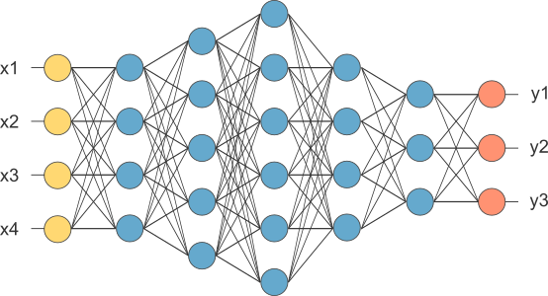
Deep neural networks are chains of interconnected mathematical operations

Slide 5
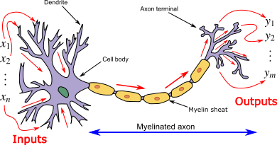
Each network node can have several input and output connections
X₁
X₂
X₃

Slide 6
In each node inputs are weighted, aggregated and transformed to an output
Activation
function
X₁
w₁
f(x)
y
X₂
w₂
w₃
X₃

Slide 7
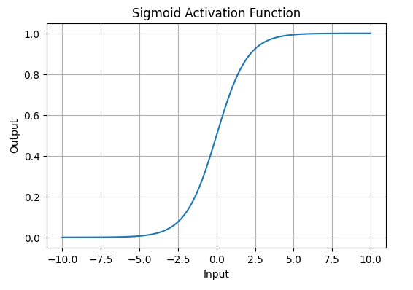
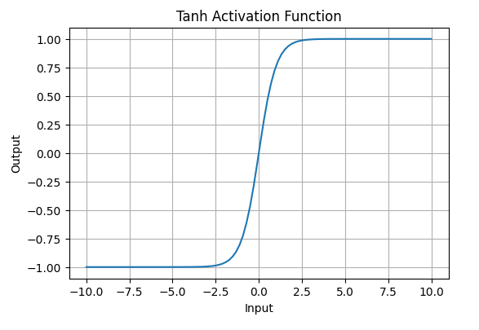
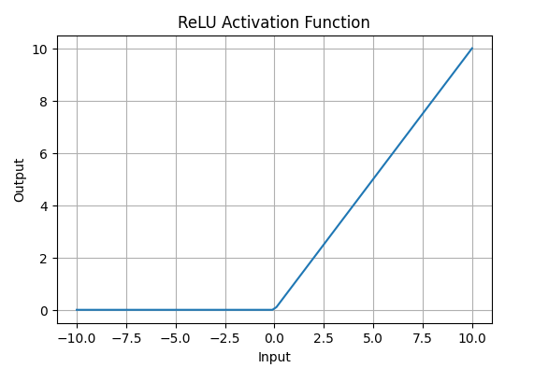
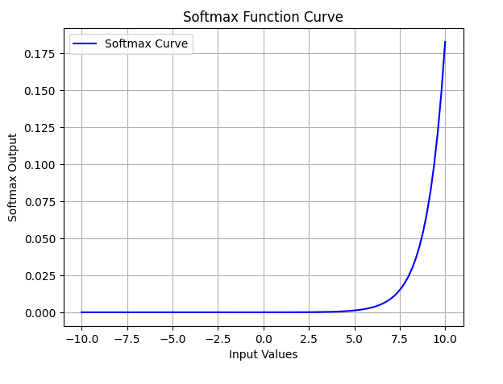
Activation functions are a crucial part of the network architecture
Activation
function
X₁
w₁
f(x)
y
X₂
w₂
w₃
X₃
https://www.geeksforgeeks.org/machine-learning/activation-functions-neural-networks/

Slide 8
Activation functions are a crucial part of the network architecture
Activation
function
X₁
w₁
f(x)
y
X₂
w₂
w₃
X₃
Non-linear
https://www.geeksforgeeks.org/machine-learning/activation-functions-neural-networks/

Slide 9
How to train a neural network…

Slide 10
How to train a neural network…
Output

Slide 11
How to train a neural network…
Error calculation
(Loss function)
Output

Slide 12
Loss function is chosen depending on the task
Classification: Binary Cross-Entropy, Categorical Cross Entropy
Regression: Mean Squared Error (MSE), Mean Absolute Error (MAE)
…
Loss function = measure of success

Slide 13
Weights and other parameters are repeatedly adjusted to reduce errors
Error calculation
(Loss function)
Output
Adjustment

Slide 14
How to find the best AI model/system
AI model = the learned computational structure
AI system = integration of model(s) into a larger structure (data, processing pipelines, data, etc.)
Simple first: baseline
→ Test multiple architectures for models and systems
→ Gradual optimization
Train
Evaluate
Adjust

Slide 15
AI can be trained in multiple ways
Supervised
learning
Labeled data (x,y)
Defined target
Aim: mapping function x -> y
Common uses: regression, classification
Unsupervised
learning
Unlabeled data
No defined target
Aim: Learn structure of the data
Common uses: clustering, dimensionality reduction

Slide 16
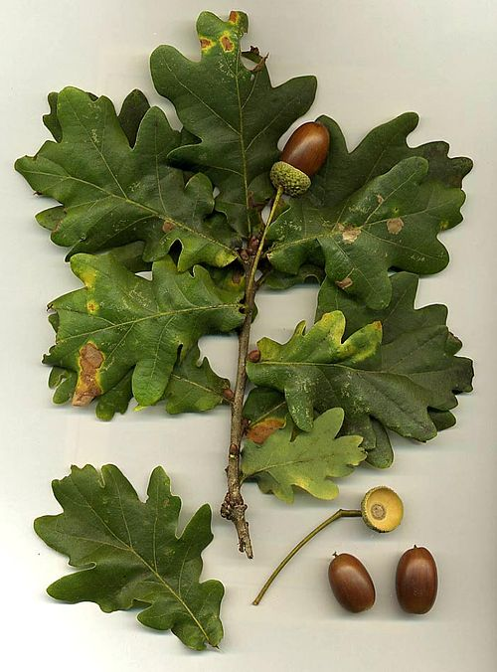
Supervised learning
Oak

Slide 17

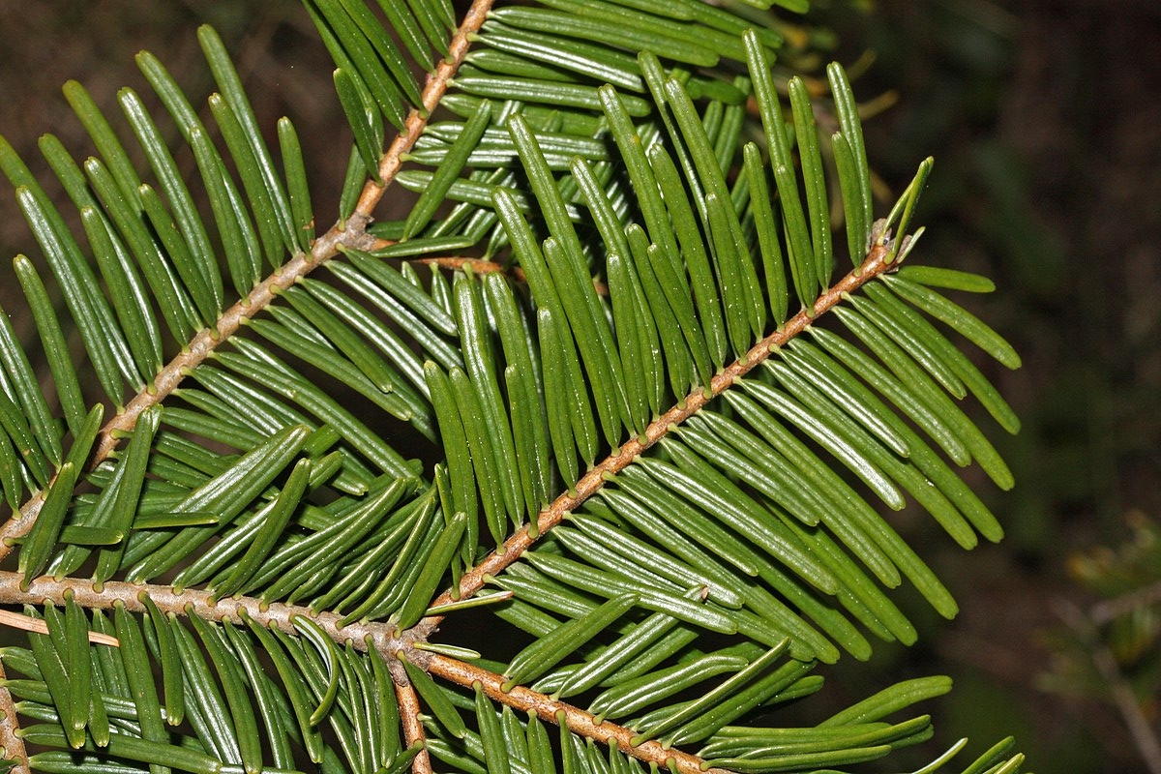


Unsupervised learning

Slide 18
Other learning paradigms
Semi-supervised learning: learning from a mix of labeled and unlabeled data
Self-supervised learning: learning from unlabeled data using pretext tasks for supervision
Reinforcement learning: learning by rewarding/penalizing actions

Slide 19
Transfer learning enables more efficient AI training
Dataset
1
AI Model 1
general
domain capabilities

Slide 20
Transfer learning enables more efficient AI training
Dataset
1
Fine-tuning
AI Model 1
general
domain capabilities
Dataset
2
AI Model 2
specialized
capabilities

Slide 21
Ultimate training goal
Train model that performs well on previously unseen data
→ Model can generalize

Slide 22
Capability ≠ Understanding

Slide 23
Summary
Deep learning relies on deep neural networks that learn from examples rather than explicit instruction
AI development is an iterative process
Training relies on the repeated adjustment of network parameters to minimize the loss function; there are several learning paradigms which can also be combined
Models can be trained to perform tasks but do not understand the task as humans

